Slide 1



Department of Computer Science and Engineering
Project Phase – II (18CSP83)
Review – 1
A NEW IoT GATEWAY FOR SMART AGRICULTURE
Group No.:06 Batch No.:2021_CSE_10
1KS18CS067 Poojashree K
1KS18CS072 Preethi K
1KS18CS082 Rekha N.C
1KS18CS090 Shalini S
Guided By:
Mr. Raghavendrachar S
Assistant Professor
Dept of CSE, KSIT

Slide 2
Contents
Introduction
Comparison with similar work
Problem Statement and Objectives
Methodology Proposed/ Design
Technologies and Tools Used
Implementation of Modules with codes
Snapshots
References

Slide 3
Introduction
In general, agriculture is the backbone of India and also plays an important role in Indian economy by providing a certain percentage of domestic product to ensure the food security.
The Internet of things (IoT) integrates technological systems using virtual network communication and cloud data bases.
This project aims to convert the irrigation to smart irrigation by using high technology and the Internet of things.
The modules can be controlled through Internet medium using a Android smart phone.
The whole process calculation, processing, monitoring are designed with motors & sensor interfaced with microcontroller. Using Internet of things the robot is controlled.

Slide 4
Comparison with similar work
Existing System | Proposed System
Separate projects are done on agribot,warehouse management and soil moisture detection. | Three nodes robot,warehouse management,and soil moisture detection are connected together and interacted using blynk application.
Only PIR Sensor is used for animal detection hence it will simply ON the buzzer whoever enters into the field. | Along with PIR sensor we are also using picamera to detect the animals that enter into the field.
Uses low power Bluetooth and low power wide area network communication modules. | Uses smart farm type along with extra feature wifi module.
There is no proper communication between former and the robot. | Blynk application through mobile phone is used for giving instruction.
Notes:
Arduino is an open-source product, software/hardware which is accessible and flexible to customers.
Arduino is flexible because of offering variety of digital and analog pins, SPI and PWM outputs.
Arduino is easy to use, connected to a computer via a USB and communicates using serial protocol.
Inexpensive, around 500 rupees per board with free authoring software.
Arduino has growing online community where lots of source code is available for use, share and post examples for others to use too. Arduino is Cross-platform, which can work on Windows, Mac or Linux platforms.
Arduino follows Simple, clear programming environment as C language.

Slide 5
PROBLEM STATEMENT AND OBJECTIVES
Problem Statement
The problem statement defined is , “Designing a robot for performing all the agriculture related operations , to scare the animals that enter into the field, providing irrigation facility by knowing the soil condition and to develop a warehouse management system using different sensors”.
Objectives
This multipurpose system gives an advance method to sow, plow, water and cut the crops with minimum man power and labor making it an efficient vehicle.
To build a robot that can do all basic agricultural activities including scaring of animals that enter into the field.

Slide 6
The proposed system will be able to measure important parameters of the crop and send out the information to the field manager and this data can be analysed by the field manager to take the necessary action to improvise the crop of his/her field.
Warehouse management system to provide suitable environment for storing crop.
To build communication network between the nodes and user using blynk application

Slide 7
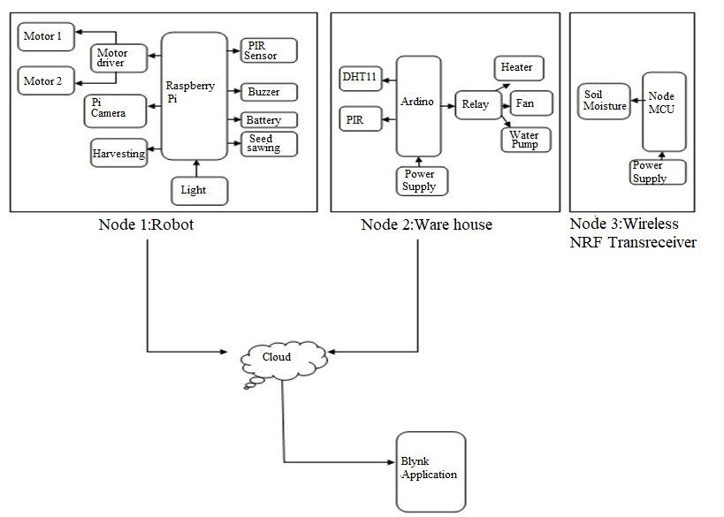
Methodology

Slide 8
In this project we will be fabricating a multipurpose irrigation vehicle that will be able to DIG the Earth, Sow the seeds and Cultivate the crop after the harvest is ready.
We will be using an android smart phone application to control the vehicle to respond to the control signal .
This type of vehicle should be useful for the farmers as a low investment option instead of buying 2 or more machines to do this work done by a single machine of ours that is the Robotic node.
The next is warehouse node in which it will measure the temperature and humidity and also if any rats and rodents present in the warehouse we will get the information to mobile phone .
Next node is Wireless NRF Transreceiver it will measure the moisture content in the soil from the crop field all this information send to the cloud through IoT and from the cloud we can access the information from the mobile application so that the necessary actions will be taken.

Slide 9
Technologies and Tools used
HARDWARE REQUIREMENT:
Node MCU
Raspberry Pi
Arduino
PIR Sensor
Relay
Buzzer
Battery
DC Motor
L293D Motor Driver
DHT11 Sensor
Soil moisture Sensor
SOFTWARE REQUIREMENT:
Arduino IDE
Mobile App
Python
Pycharm
Pandas
SK learn

Slide 10
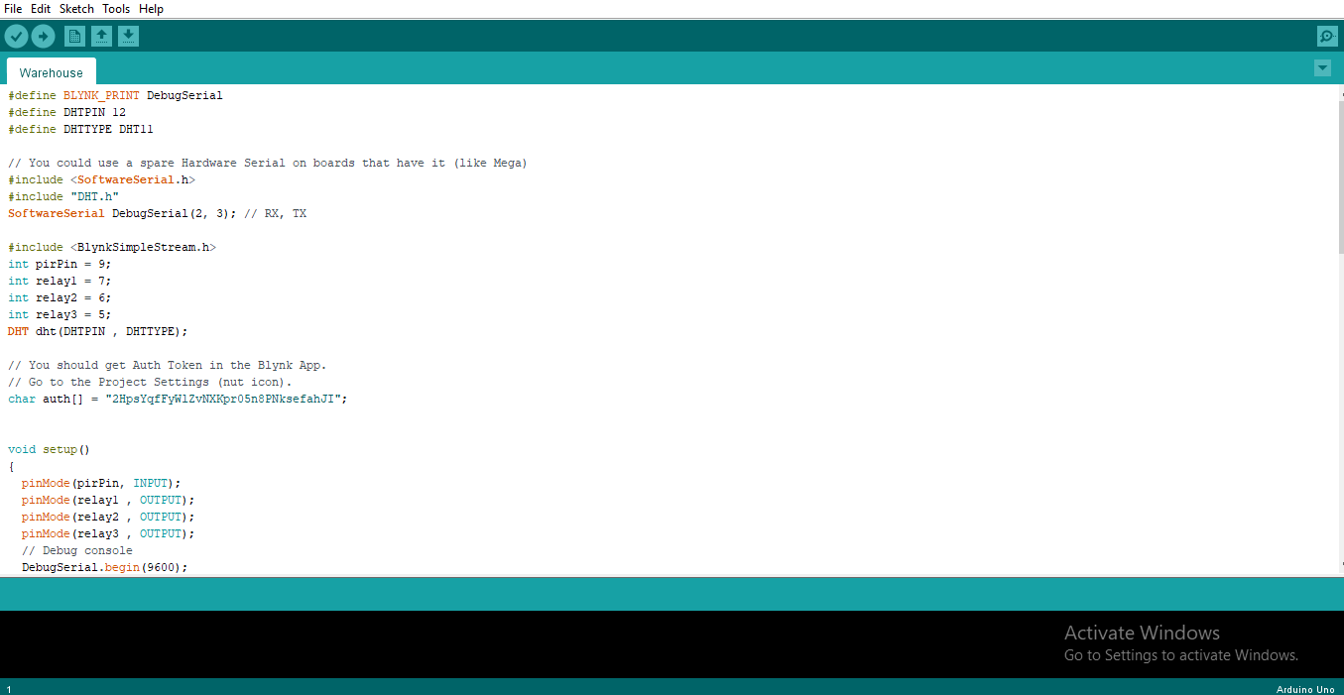
Implementation of modules with codes

Slide 11
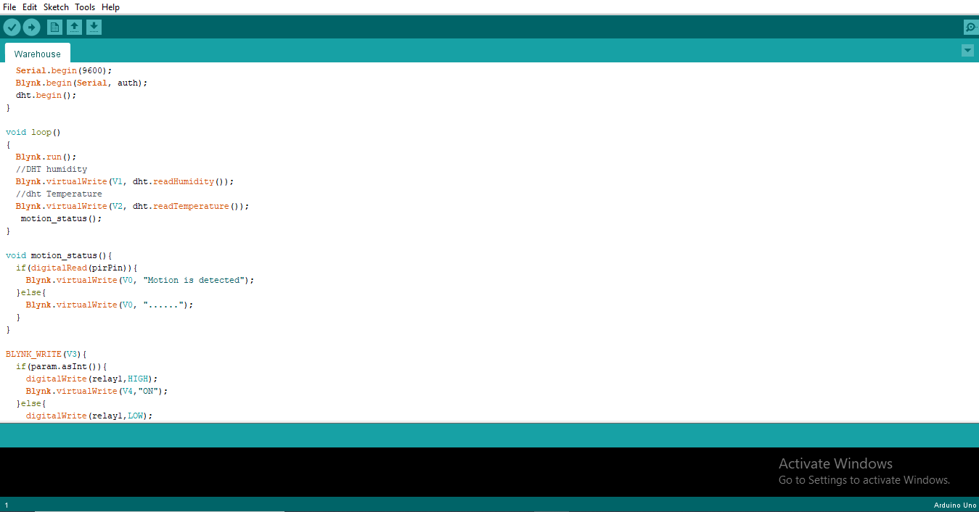

Slide 12
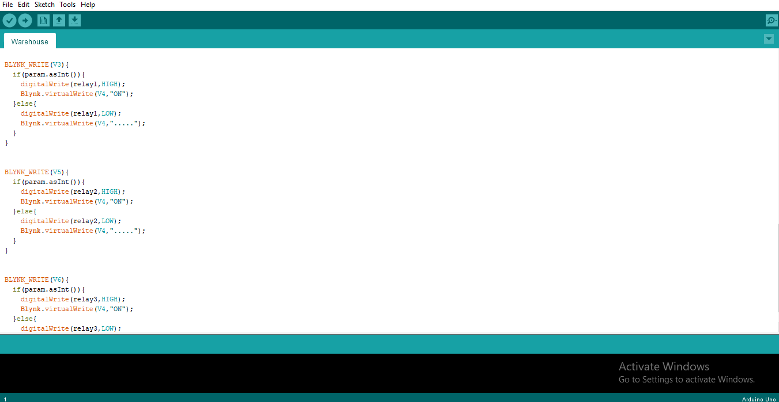

Slide 13
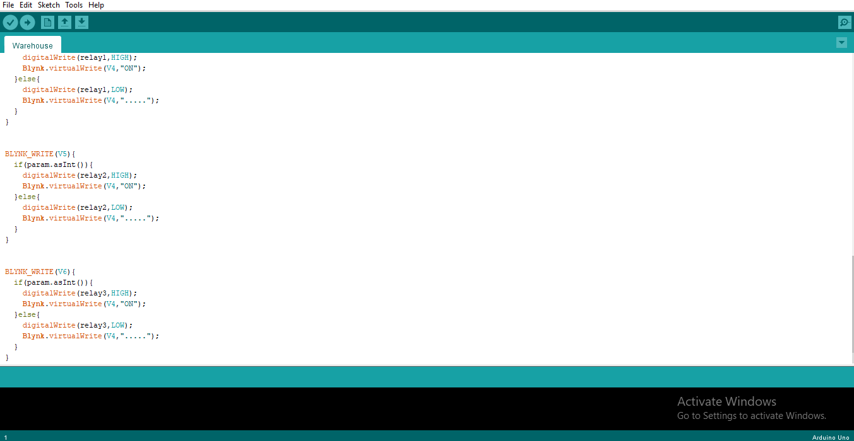

Slide 14
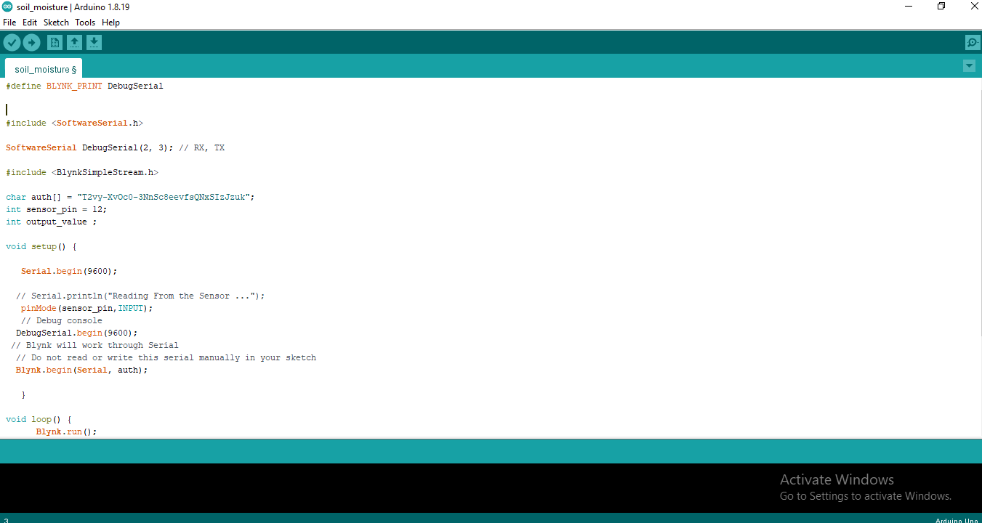

Slide 15
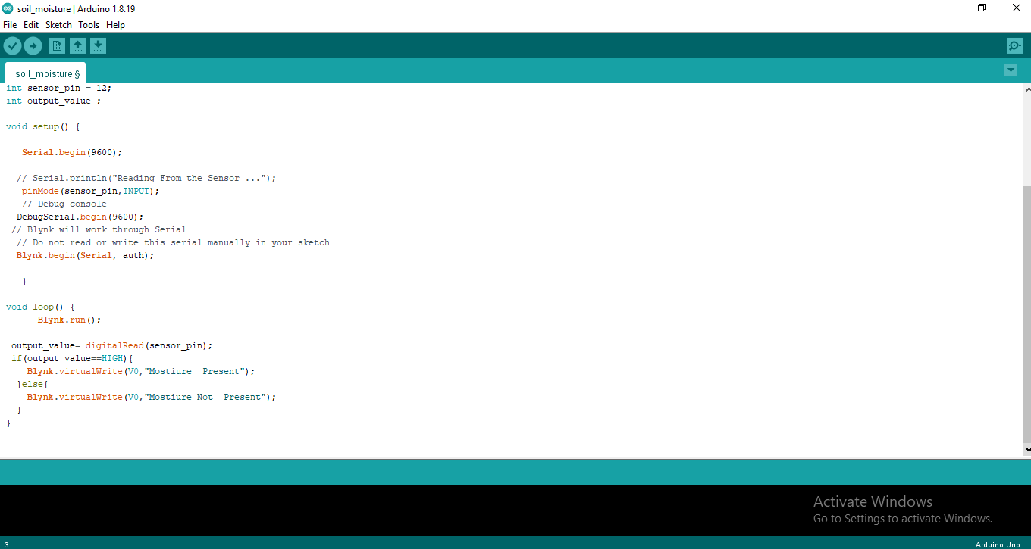

Slide 16
References
[1] Shivangi Vashi, Jyotsnamayee Ram, Janit Modi, Saurav Verma and Dr. Chetana Prakash, "Internet of Things (IoT): A vision, architectural elements, and security issues," 2017 International Conference on I-SMAC (IoT in Social, Mobile, Analytics and Cloud) (I-SMAC), Palladam, 2017, pp. 492-496.
[2]Stefano Giordano, Ilias Seitanidis , Mike Ojo, Davide Adami and Fabio Vignoli, "IoT solutions for crop protection against wild animal attacks," 2018 IEEE International Conference on Environmental Engineering.
[3] Chiyurl Yoon, Miyoung Huh, Shin-Gak Kang, Juyoung Park and Changkyu Lee, "Implement smart farm with IoT technology," 2018 20th International Conference on Advanced Communication Technology (ICACT), Chuncheon-siGangwon-do, Korea (South), 2018, pp. 1-2.
[4] Rodrigo Filev Maia, Ibrahim Netto and Anh Lan Ho Tran, "Precision agriculture using remote monitoring systems in Brazil," 2017 IEEE Global Humanitarian Technology Conference (GHTC), San Jose, CA, 2017, pp. 1-6.
[5] Mr. V. Gowrishankar and Dr. K.Venkatachalam ,”IoT Based Precision Agriculture using Agribot”,2018 GRD Journal for Engineering ISSN:2455-5703
[6] Utsav Dihingia, P. Amar, M. Megha Shyam, Vaibhav Thomas, S. Chidambaram, “Animal Identification Using Deep Learning on Raspberry Pi”,2020 International Journal of Research in Engineering, Science and Management(IJRSESM).

